Slide 1

REAL-TIME SIGN LANGUAGE DETECTION
PRESENTED BY: DEEPAK K (222209774)
DINESH S (222209777)

Slide 2
01
Introduction
02
Problem Statement
Table of Content
03
Proposed Solution
04
System Architecture
05
Dataset Collection & Preprocessing

Slide 3
06
CNN Model Design
07
System Implementation
Table of Content
08
Results & Discussion
09
Screenshots & Demonstration
10
Conclusion

Slide 4
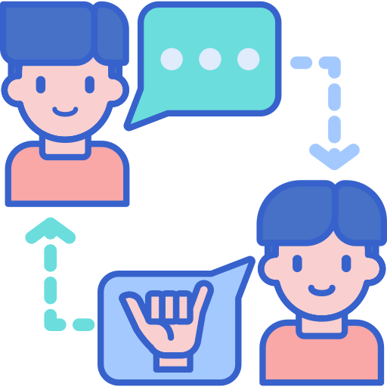
Introduction
This project focuses on developing a Real-time Sign Language Translator using AI, Computer Vision, and Machine Learning to bridge communication gaps for the Deaf and Hard of Hearing. It uses CNN and Mediapipe’s hand tracking to detect gestures and translate them into text, providing an accessible and cost-effective solution.

Slide 5
Problem Statement
Communication barriers exist for sign language users.
Traditional solutions like human interpreters are costly.
Need for an accessible, scalable,
and cost-effective system.
Existing AI solutions lack real-time efficiency and accuracy.

Slide 6
Proposed Solution
Machine Learning
CNN model trained on sign language dataset.
Scalability
Future support for multiple sign languages.
Gesture Detection
Mediapipe’s hand tracking technology.
User Interface
Real-time text output using CustomTkinter.
Low Latency
Optimized processing ensures real-time translation.

Slide 7
System Architecture
Input
Classification
Webcam captures real-time gestures.
Predicts the corresponding sign
Processing
Output
Image preprocessing, feature extraction via CNN.
Displays recognized text in the UI

Slide 8
Dataset Collection & Preprocessing
Dataset Sources
Used ASL Alphabet and Custom Hand Gesture Datasets for diverse and comprehensive gesture recognition.
Preprocessing Techniques
Applied resizing, normalization, and augmentation for consistency and generalization.
Robustness
Added noise to enhance model robustness against real-world variations.

Slide 9
Input Layer
I
F
Feature Extraction
Preprocessed hand gesture images
Convolutional and pooling layers
CNN
Model
Design
C
T
Classification
Training
Fully connected layers with Softmax activation
70% training, 15% validation,
15% testing

Slide 10
System Implementation
Tools Used
Python, TensorFlow, OpenCV, Mediapipe.
Real-Time Detection
Low latency (<1 sec) using optimized pipelines.
Integration
CNN model integrated with OpenCV for live classification.
User Interface
Tkinter-based UI for seamless interaction.

Slide 11
Results & Discussion
Achievements
Challenges
Successfully translates predefined hand gestures into text.
Limited to predefined gestures
Future Enhancements
More gestures, multilingual support, voice output.

Slide 12
Screenshots & Demonstration

Slide 13
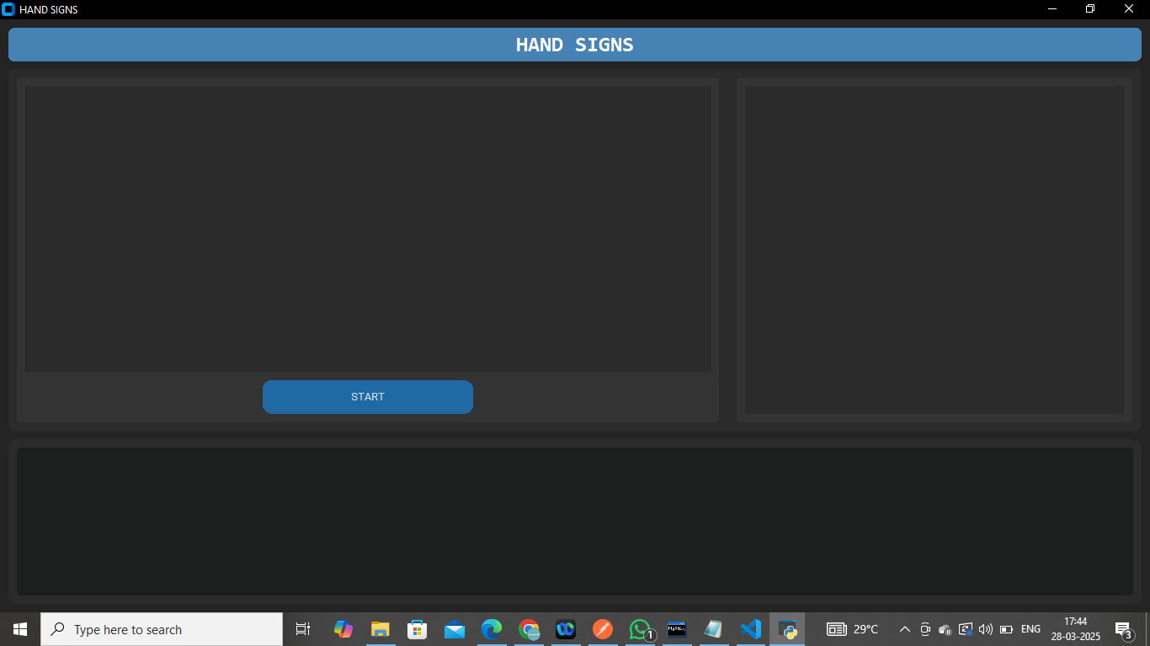
User Interface Overview

Slide 14
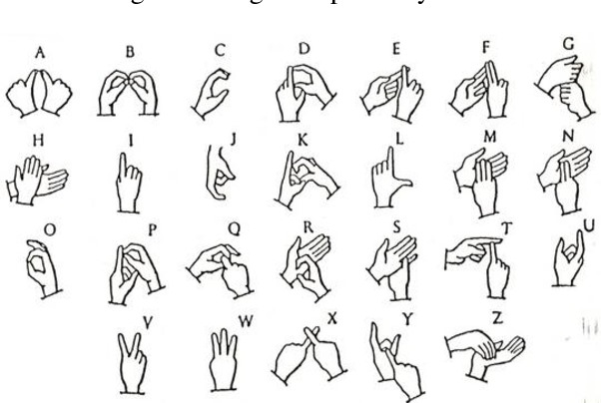

Real-Time Detection Screenshots

Slide 15
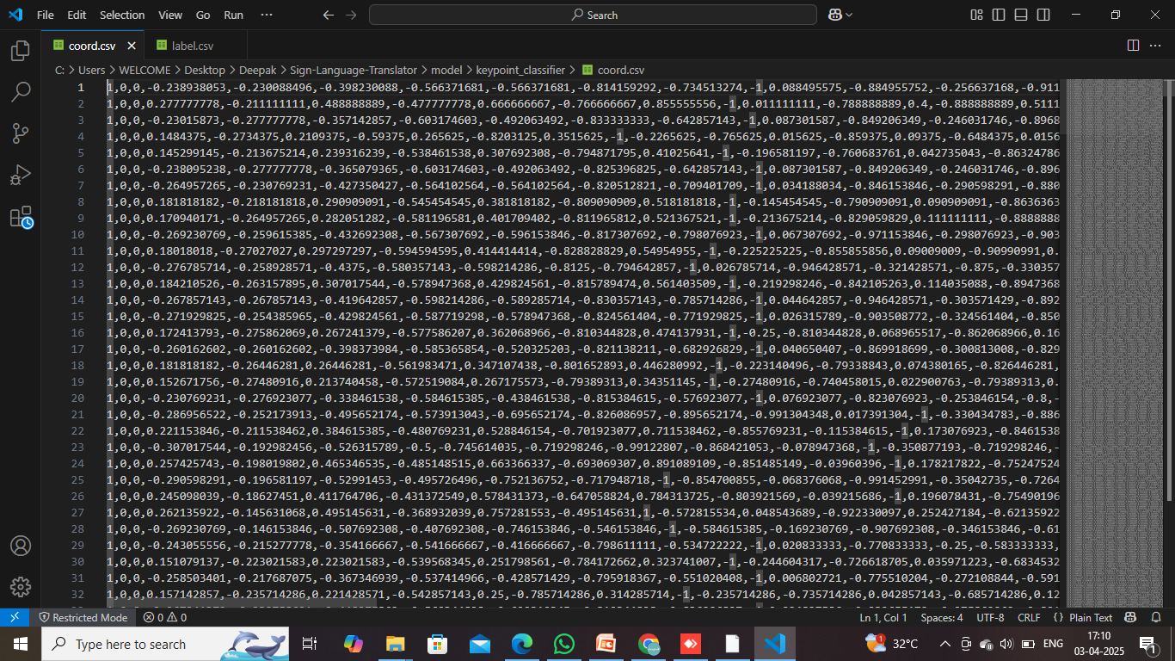
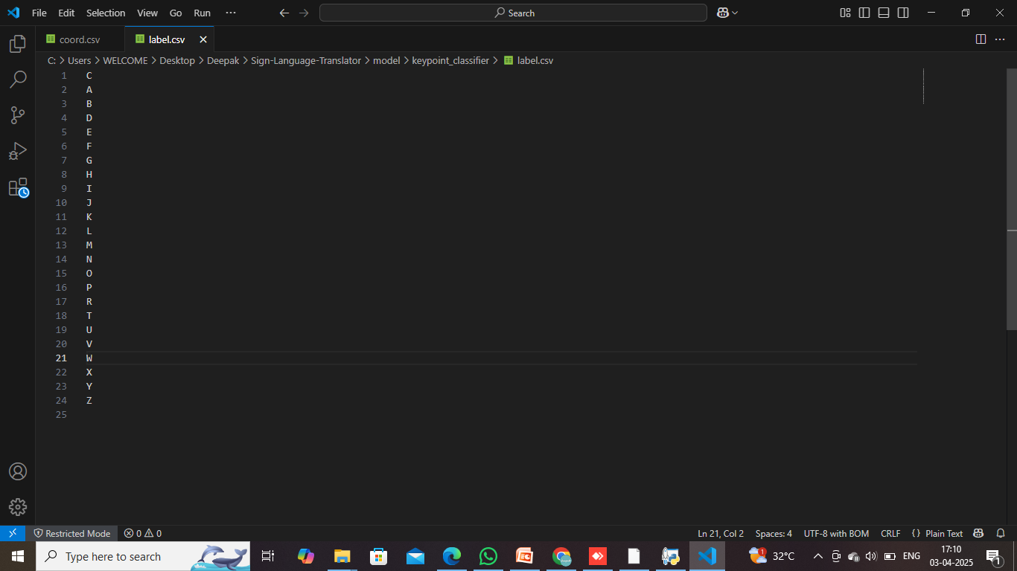
Model Training Process

Slide 16
Conclusion
Impact
Provides an accessible tool for sign language communication
Scalability
Designed for future improvements and integrations
Significance
Encourages inclusivity through AI-powered solutions

Slide 17
Thank You

